Slide 1
Binary Search Trees

Slide 2
The Dictionary Data Structure
A dictionary stores a dynamically changing set S and supports the following operations:
  Insert(x): Insert element x into S
  Delete(x): Removes element x from S
  Find(x): Decides whether x is in S and, if so, reports x
If the elements in S can be compared, the following operations are also desirable:
  Successor(x) / Predecessor(x): Reports the next larger / smaller element from x in S
  Minimum / Maximum: Reports the smallest / largest element in S
  Range-Search(x, y): Reports all elements z in S such that
  x ≤ z ≤ y

Slide 3
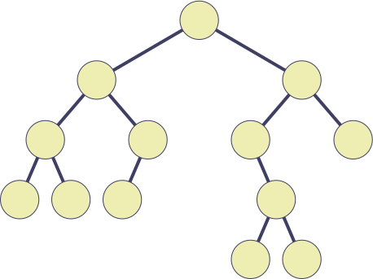
Binary Search Tree Property
A binary search tree is a binary tree with the following binary search tree property:
For any node v, the elements stored in the left subtree of v are not greater than the element stored at v; the elements in the right subtree are not less than the element stored at v.
18
13
37
5
17
19
51
1
7
14
30
25
34

Slide 4
Inorder Walk Algorithm
The binary-search-tree property allows us to print all the keys in tree in sorted order by simple recursive algorithm, called an inorder walk in Θ(n).
Inorder-tree-walk(v)
1 If v ≠ nil
2 Then Inorder-tree-walk(left(v))
3 Print key(v)
4 Inorder-tree-walk(right(v))

Slide 5
The Find Operation — Searching for an Element
Goal: Identify the node storing a given element x, if such a node exists.
18
13
37
5
17
19
51
1
7
14
30
25
34
x = 25

Slide 6
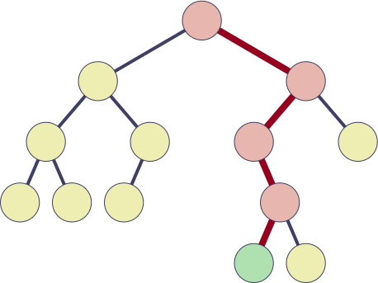
The Find Operation — Searching for an Element
Goal: Identify the node storing a given element x, if such a node exists.
18
Find(x, T)
1 v ← root(T)
2 while v ≠ nil and x ≠ key(v)
3 do if x < key(v)
4 then v ← left_child(v)
5 else v ← right_child(v)
6 return v
13
37
5
17
19
51
1
7
14
30
25
34
x = 25

Slide 7
The Find Operation — Searching for an Element
Goal: Identify the node storing a given element x, if such a node exists.
18
Lemma: If element x is stored in T, procedure Find finds the node storing x.
13
37
5
17
19
51
1
7
14
30
Lemma: The running
time of procedure Find is O(height(T)).
25
34
x = 25

Slide 8
The Minimum Operation — Finding the Smallest Element
Goal: Find the smallest element in S.
18
13
37
5
17
19
51
1
7
14
30
25
34

Slide 9
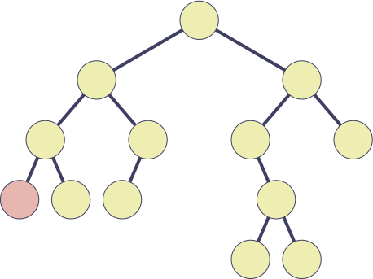
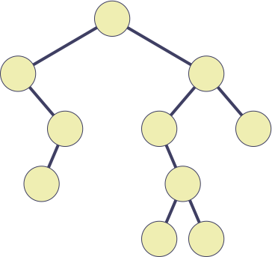
The Minimum Operation — Finding the Smallest Element
Goal: Find the smallest element in S.
18
18
13
37
13
37
5
17
19
51
17
19
51
1
7
14
30
14
30
25
34
25
34

Slide 10
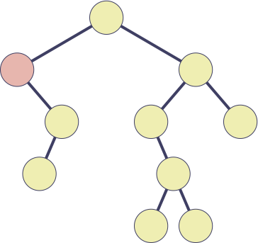
The Minimum Operation — Finding the Smallest Element
Goal: Find the smallest element in S.
18
18
13
37
13
37
5
17
19
51
17
19
51
1
7
14
30
14
30
25
34
25
34

Slide 11
The Minimum Operation — Finding the Smallest Element
Goal: Find the smallest element in S.
Minimum(T)
1 v ← root(T)
2 if v ≠ nil
3 then return Subtree-Minimum(v)
4 else return nil
Subtree-Minimum(v)
1 while left_child(v) ≠ nil
2 do v ← left_child(v)
3 return v
18
13
37
5
17
19
51
1
7
14
30
25
34
Lemma: The running time
of procedure Minimum is O(height(T)).

Slide 12
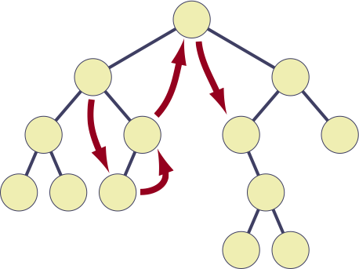
The Successor Operation — Finding the Next Element
Goal: Given an element x ∈ S, find the next larger element y ∈ S.
Successor(v)
1 if right_child(v) ≠ nil
2 then return Subtree-Minimum(right_child(v))
3 w ← parent(v)
4 while w ≠ nil and v = right(w)
5 do v ← w
6 w ← parent(w)
7 return w
18
13
37
5
17
19
51
1
7
14
30
25
34

Slide 13
The Successor Operation — Finding the Next Element
Goal: Given an element x ∈ S, find the next larger element y ∈ S.
Successor(v)
1 if right_child(v) ≠ nil
2 then return Subtree-Minimum(right_child(v))
3 w ← parent(v)
4 while w ≠ nil and v = right(w)
5 do v ← w
6 w ← parent(w)
7 return w
Lemma: The running time of procedure Successor is O(height(T)).

Slide 14
The Insert Operation — Inserting a New Element
Goal: Insert a new element x into the dictionary.
18
13
37
5
17
19
51
1
7
14
30
25
34

Slide 15
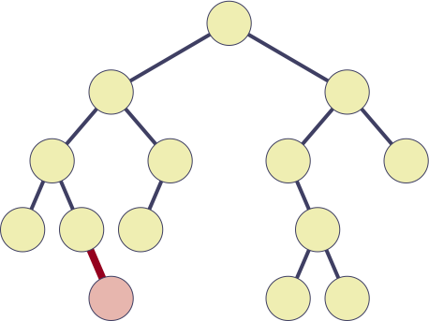
The Insert Operation — Inserting a New Element
Goal: Insert a new element x into the dictionary.
Insert(x, T)
1 v ← root(T)
2 w ← nil
3 while v ≠ nil
4 do w ← v
5 if x < key(v)
6 then v ← left_child(v)
7 else v ← right_child(v)
8 u ← new node with key x
9 if w = nil
10 then root(T) ← u
11 else parent(u) ← w
12 if x < key(w)
13 then left_child(w) ← u
14 else right_child(w) ← u
18
13
37
5
17
19
51
1
7
14
30
9
25
34

Slide 16
The Insert Operation — Inserting a New Element
Goal: Insert a new element x into the dictionary.
Insert(x, T)
1 v ← root(T)
2 w ← nil
3 while v ≠ nil
4 do w ← v
5 if x < key(v)
6 then v ← left_child(v)
7 else v ← right_child(v)
8 u ← new node with key x
9 if w = nil
10 then root(T) ← u
11 else parent(u) ← w
12 if x < key(w)
13 then left_child(w) ← u
14 else right_child(w) ← u
Lemma: Procedure Insert preserves the binary search tree property.
Lemma: The running time of procedure Insert is O(height(T)).

Slide 17
The Delete Operation — Deleting Element
Goal: Delete an element x from the dictionary.
18
13
37
5
17
19
51
1
7
14
30
25
34

Slide 18
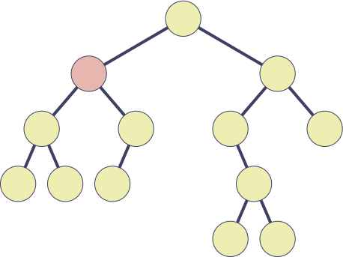
The Delete Operation — Deleting Element
Goal: Delete an element x from the dictionary.
18
13
37
5
17
19
51
1
7
14
30
25
34

Slide 19
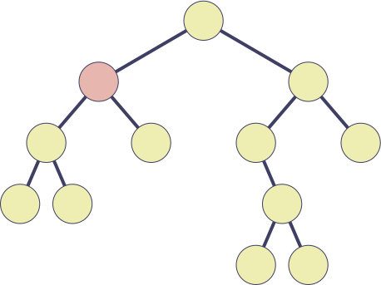
The Delete Operation — Deleting Element
Delete(v, T)
1 if left_child(v) = nil or right_child(v) = nil
2 then w ← v
3 else w ← Successor(v)
4 if left_child(w) ≠ nil
5 then u ← left_child(w)
6 else u ← right_child(w)
7 if u ≠ nil
8 then parent(u) ← parent(w)
9 if parent(w) = nil
10 then root(T) ← u
11 else if w = left_child(parent(w))
12 then left_child(parent(w)) ← u
13 else right_child(parent(w)) ← u
14 if w ≠ v
15 then key(v) ← key(w)
16 Delete node w
Goal: Delete an element x from the dictionary.
18
14
37
5
17
19
51
1
7
30
25
34

Slide 20
The Delete Operation — Deleting Element
Delete(v, T)
1 if left_child(v) = nil or right_child(v) = nil
2 then w ← v
3 else w ← Successor(v)
4 if left_child(w) ≠ nil
5 then u ← left_child(w)
6 else u ← right_child(w)
7 if u ≠ nil
8 then parent(u) ← parent(w)
9 if parent(w) = nil
10 then root(T) ← u
11 else if w = left_child(parent(w))
12 then left_child(parent(w)) ← u
13 else right_child(parent(w)) ← u
14 if w ≠ v
15 then key(v) ← key(w)
16 Delete node w
Goal: Delete an element x from the dictionary.
Lemma: The running time of procedure Delete is O(height(T)).
Lemma: Procedure Delete preserves the binary search tree property.

Slide 21
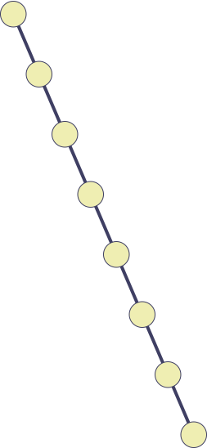
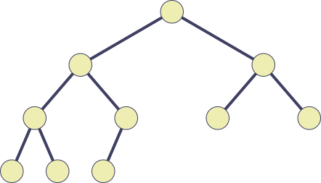
Binary Search Tree Operations—Summary
Theorem: A binary search tree supports operations Insert, Delete, Find, Minimum, Maximum, Predecessor, and Successor in O(height(T)) time.
Best case:
Tree is complete
Height is Θ(lg n)
Worst case:
Tree is a linked list
Height is Θ(n)

